Slide 1
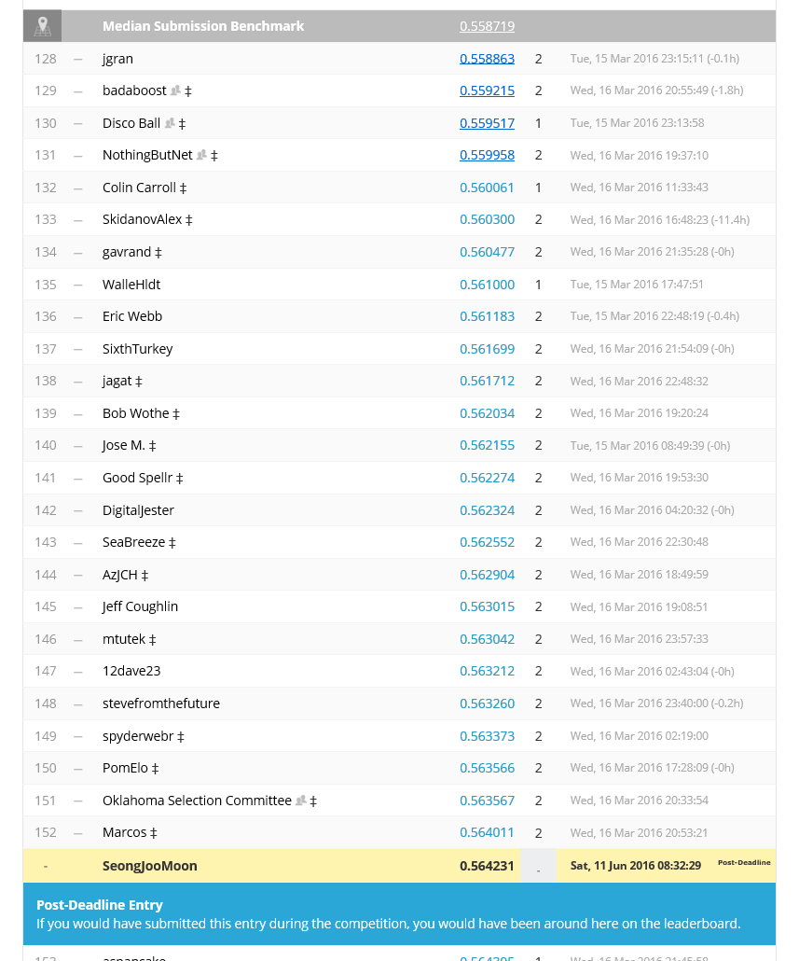
Hidden layer :1
Hidden unit : 74
With standardscaler
No regularization
With drop out (0.5)
152등

Slide 2
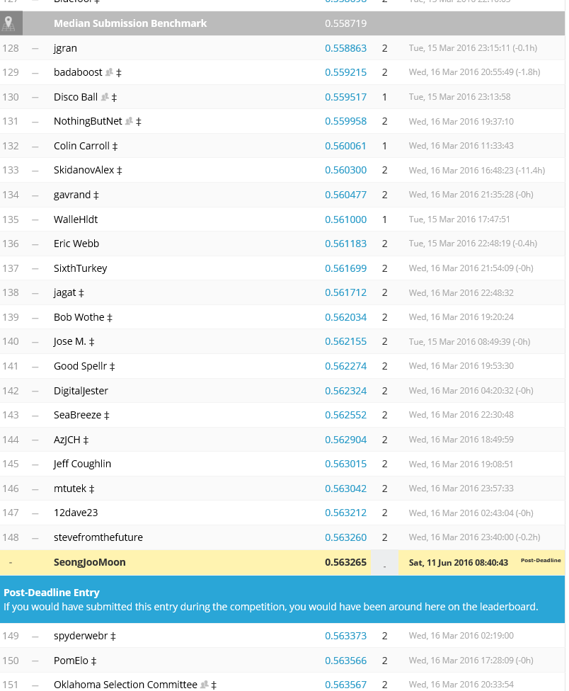
Hidden layer :1
Hidden unit : 37
With standardscaler
No regularization
With drop out (0.5)
148등

Slide 3
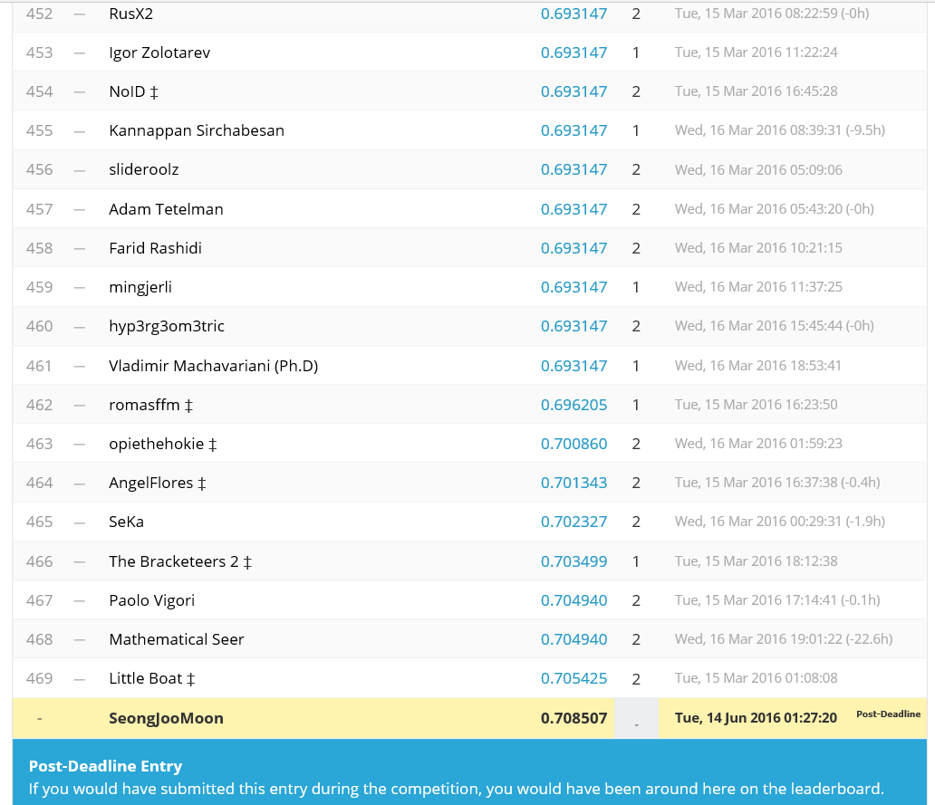
With sklearn
469등

Slide 4
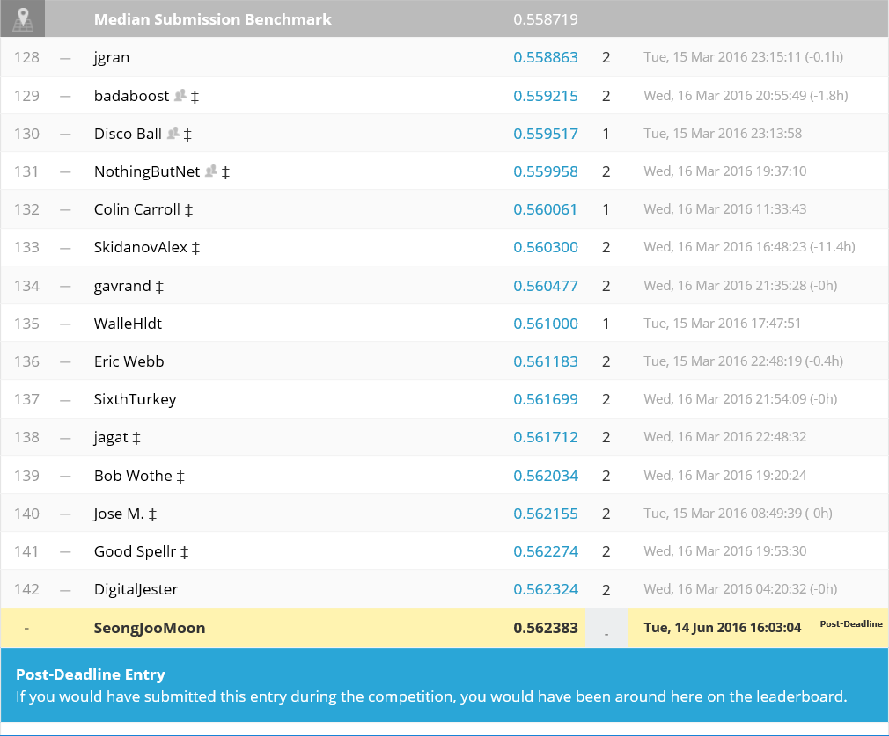
Hidden layer :2
Hidden unit : 60,38
With standardscaler
No regularization
142등

Slide 5
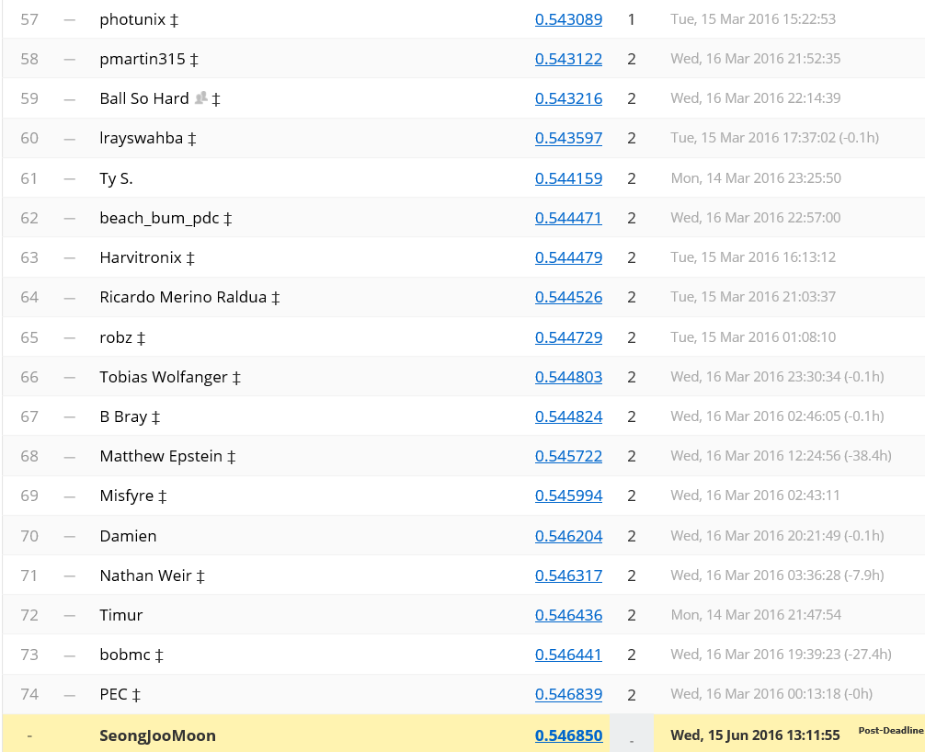
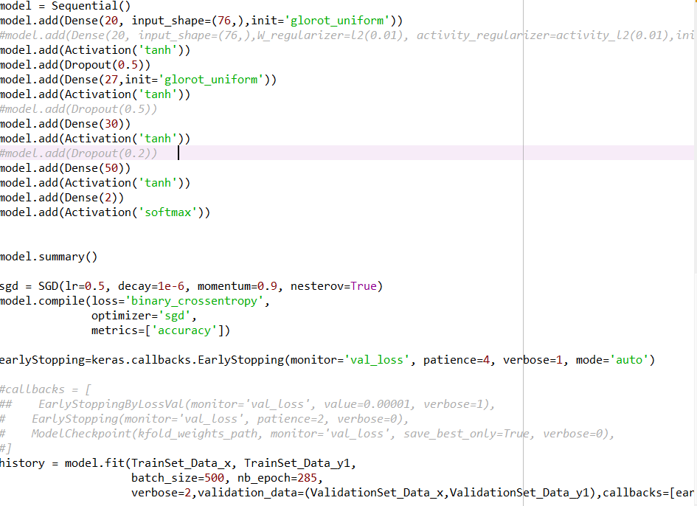
Feature :76

Slide 6
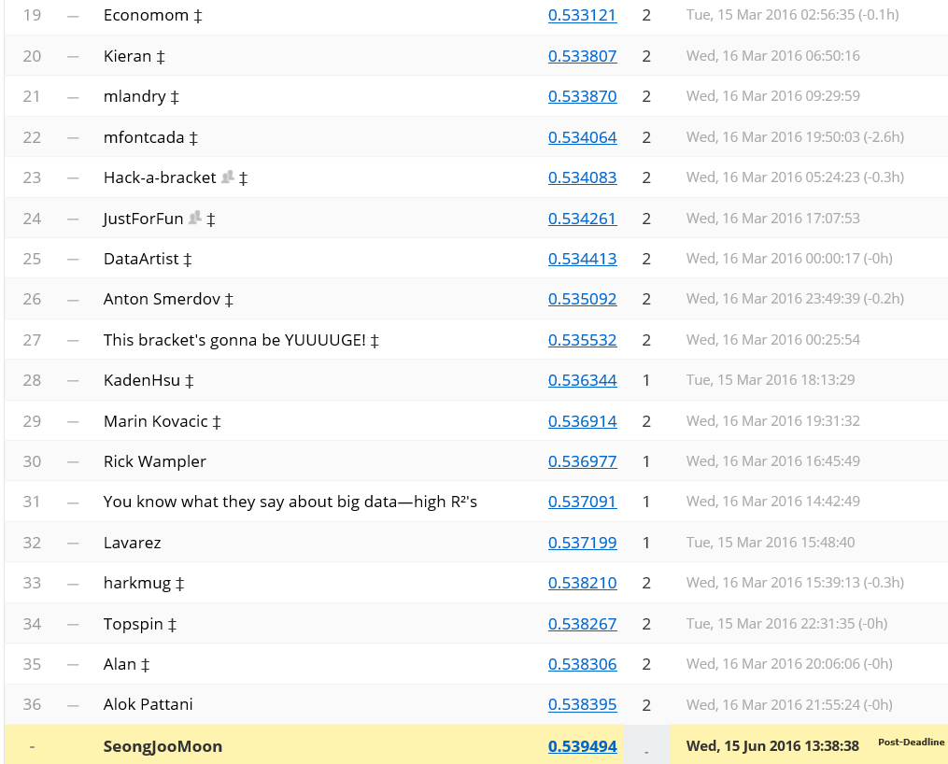
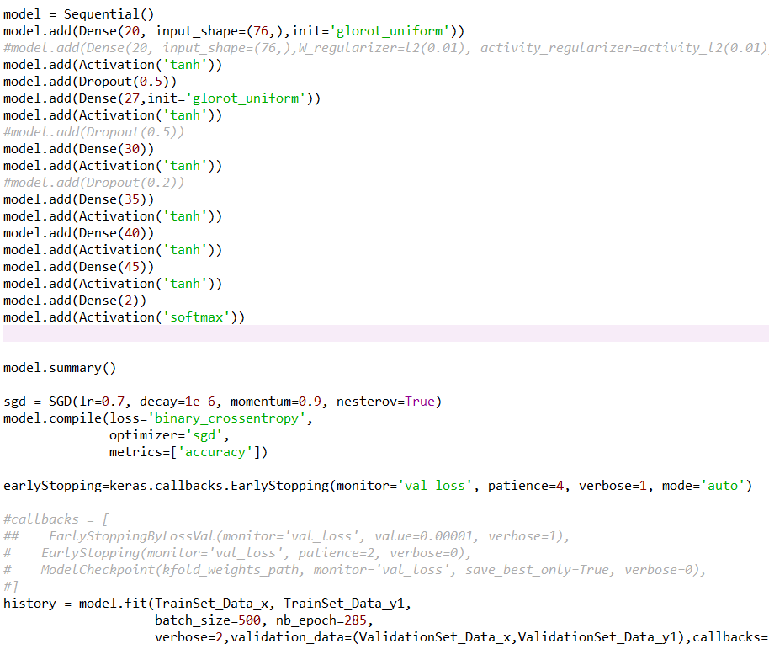
Feature :76

Slide 7
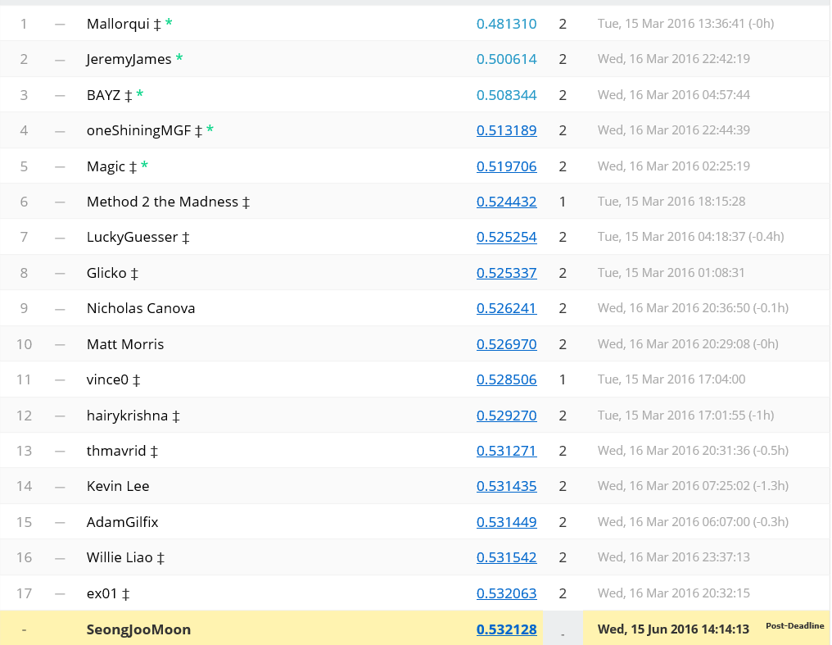
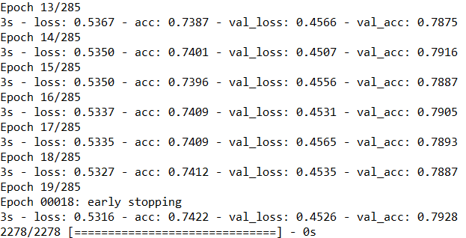
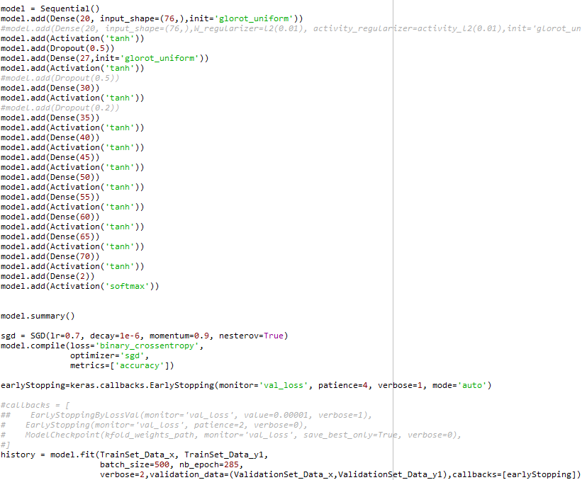
Feature :76

Slide 8
